Slide 1
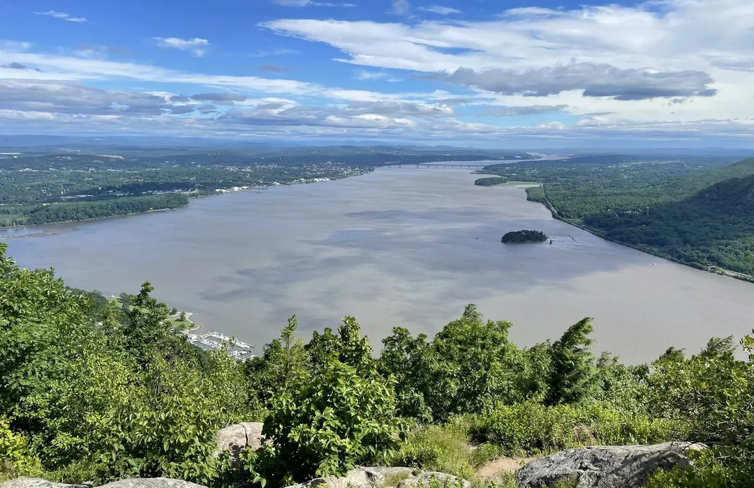
Cornwall Central School District
2025 – 2026 Proposed Budget
March 10, 2025
"Striving for Excellence Every Day”
Cornwall Central High School Cornwall Central Middle School Cornwall-on-Hudson Elementary School Cornwall Elementary School Willow Avenue Elementary School

Slide 2
Vision
We envision a school district in which every staff member is a source of knowledge and inspiration, every building is a place of safety and support, every leader is a pillar of integrity, and every student is a source of pride.
Cornwall Central High School Cornwall Central Middle School Cornwall-on-Hudson Elementary School Cornwall Elementary School Willow Avenue Elementary School

Slide 3
Agenda
Budget Goals, 1st Steps & Next Steps
Budget Development Process
Preliminary & Revised Expenditures
Revised Budget – The How?
Preliminary & Revised Revenues
Preliminary & Revised Budget Summary
Revised Budget Recap
Budget Goals
Fund Balance and Reserves
CCSD – Farm Analogy
Budget Calendar & Questions
Cornwall Central High School Cornwall Central Middle School Cornwall-on-Hudson Elementary School Cornwall Elementary School Willow Avenue Elementary School

Slide 4
2025-26 Budget Goals, 1st Steps & Next Steps
2025-26 Budget Goals:
Lowest possible tax levy increase, but above all -- stay within the Property Tax Cap.
Maintain current programs.
Continue to support and grow instructional and operational programs.
2025-26 Budget – 1st Steps
Identify the “roll-over” budget to continue serving the needs being addressed in 2024-25. If the need does not exist after 2024-25, it is not in the roll-over budget.
2025-26 Budget – Next Steps
Reengage leadership team.
Request more information and require feedback.
Reevaluate and reconsider proposed expenditures.
Redistribute proposed allocations.
Reconcile any discrepancies.
Readjust priorities if necessary.
Realize Success!
Cornwall Central High School Cornwall Central Middle School Cornwall-on-Hudson Elementary School Cornwall Elementary School Willow Avenue Elementary School

Slide 5
Budget Development Process
Spring/Summer
Budget construction
BOE budget discussions
Budget adoption
Budget vote
On-going budget analysis
Budget closeout
Audit preparation
Budget assessment
Budget opening
External Audit
Set tax levy
Set reserves
The development of the budget is a continuous, year-round process.
Winter/Spring
Audit submission
Budget calendar
Budget builders meetings
Needs assessments
On-going budget analysis
Fall
Cornwall Central High School Cornwall Central Middle School Cornwall-on-Hudson Elementary School Cornwall Elementary School Willow Avenue Elementary School

Slide 6
2025-26 Preliminary Expenditures (Budget)
2025-26 Preliminary Budget (roll-over budget) | 2024-25 Approved Budget | Budget-to-Budget Increase
$ 93,448,962 | $ 90,260,773 | $ 3,188,189
Open Items:
Special education annual reviews
Out-of-district placements
Required related services (e.g., OT, PT, Speech, Counseling, 1:1 Aides)
Graduating students
Pre-school students moving up into District
Contract Negotiations
Teachers, Administrators and Clerical Units
Cornwall Central High School Cornwall Central Middle School Cornwall-on-Hudson Elementary School Cornwall Elementary School Willow Avenue Elementary School

Slide 7
2025-26 Revised Expenditures (Budget)
2025-26 Revised Budget | 2024-25 Approved Budget | Budget-to-Budget Increase
$ 92,721,136 | $ 90,260,773 | $ 2,460,363
Open Items:
Special education annual reviews
Out-of-district placements
Required related services (e.g., OT, PT, Speech, Counseling, 1:1 Aides)
Graduating students
Pre-school students moving up into District
Contract Negotiations
Teachers, Administrators and Clerical Units
Cornwall Central High School Cornwall Central Middle School Cornwall-on-Hudson Elementary School Cornwall Elementary School Willow Avenue Elementary School

Slide 8
2025-26 Revised Budget – The How?
Teacher Attrition:
Teachers leaving the profession – retiring.
As of June 30, 2025
10 total teacher retirements.
5 teachers positions will be filled through traditional posting and hiring process.
5 teachers positions can be filled based on redistribution of staff due to enrollment or program shifts.
No teachers or staff will be but cut or excessed.
Instructional programs will continue to develop.
Cornwall Central High School Cornwall Central Middle School Cornwall-on-Hudson Elementary School Cornwall Elementary School Willow Avenue Elementary School

Slide 9
2025-26 Preliminary Revenue Projections
2025-26 Preliminary Revenue Projections | 2024-25 Projected Revenue | Budget-to-Budget Increase
$ 90,626,690 | $ 87,435,879 | $ 3,190,811
Assumptions:
Maximum allowable property tax levy increase = 3.08% = $1,615,813
3.00% property tax levy increase used in revenue projection = $1,573,862
Increase in State Aid = $1,020,442
Increase in miscellaneous revenue = $232,131
Open Items:
Final State Aid Figures
Cornwall Central High School Cornwall Central Middle School Cornwall-on-Hudson Elementary School Cornwall Elementary School Willow Avenue Elementary School

Slide 10
2025-26 Revised Revenue Projections
2025-26 Revised Revenue Projections | 2024-25 Projected Revenue | Budget-to-Budget Increase
$ 90,364,365 | $ 87,435,879 | $ 2,928,486
Assumptions:
Maximum allowable property tax levy increase = 3.08% = $1,615,813
2.50% property tax levy increase used in revenue projection = $1,311,537
Increase in State Aid = $1,020,442
Increase in miscellaneous revenue = $232,131
Open Items:
Final State Aid Figures
Cornwall Central High School Cornwall Central Middle School Cornwall-on-Hudson Elementary School Cornwall Elementary School Willow Avenue Elementary School

Slide 11
2025-26 Preliminary Budget Summary
 | Amount
Preliminary Budget (“roll-over” expenditures) | $ 93,448,962
Preliminary Revenues:
Property Tax Levy (3.00% increase) | 54,036,225
State Aid | 34,997,138
Miscellaneous | 1,593,327
Total Preliminary Revenues | 90,626,690
Current Shortfall – without Assigned Fund Balance | $ (2,822,272)
Preliminary Assigned Fund Balance | 2,500,000
Current Deficit for Instructional and Operational Needs – with Assigned Fund Balance | $ (322,272)
Cornwall Central High School Cornwall Central Middle School Cornwall-on-Hudson Elementary School Cornwall Elementary School Willow Avenue Elementary School

Slide 12
2025-26 Revised Budget Summary
 | Amount
Revised Budget (revised expenditures) | $ 92,721,136
Revised Revenues:
Property Tax Levy (2.50% increase) | 53,773,900
State Aid | 34,997,138
Miscellaneous | 1,593,327
Total Revised Revenues | 90,364,365
Current Shortfall – without Assigned Fund Balance | $ (2,356,771)
Revised Assigned Fund Balance | 2,356,771
Current Deficit for Instructional and Operational Needs – with Assigned Fund Balance | $ 0
Cornwall Central High School Cornwall Central Middle School Cornwall-on-Hudson Elementary School Cornwall Elementary School Willow Avenue Elementary School

Slide 13
2025-26 Revised Budget – Recap
2025-26 Revised Budget
$ 92,721,136
2025-26 Revised Revenue Projections
$ 90,364,365
Current Shortfall – without Assigned Fund Balance
$ (2,356,711)
Current Shortfall – with Assigned Fund Balance of $2,356,711
$ 0
Assumptions:
Maximum allowable property tax levy increase = 3.08% = $1,615,813
2.50% property tax levy increase used in revenue projection = $1,311,537
Increase in State Aid = $1,020,442
Increase in miscellaneous revenue = $232,131
Open Items:
Special education annual reviews
Out-of-district placements
Required related services (e.g., OT, PT, Speech, Counseling, 1:1 Aides)
Graduating students
Pre-school students moving up into District
Contract Negotiations
Teachers, Administrators and Clerical Units
Final State Aid Figures
Cornwall Central High School Cornwall Central Middle School Cornwall-on-Hudson Elementary School Cornwall Elementary School Willow Avenue Elementary School

Slide 14
2025-26 Budget Goals
2025-26 Budget Goals:
Lowest possible tax levy increase, but above all -- stay within the Property Tax Cap.
2.5% Property Tax Levy.
Maintain current programs.
No programs or staff were eliminated.
Continue to support and grow instructional and operational programs.
Instructional and operational programs will continue to develop.
2025-26 Additional Budget Accomplishments:
Reduce reliance on appropriated fund balance:(More info to come.)
2025-26 = $2,356,711
2024-25 = $2,824,894
2023-24 = $2,500,000
Cornwall Central High School Cornwall Central Middle School Cornwall-on-Hudson Elementary School Cornwall Elementary School Willow Avenue Elementary School

Slide 15
Fund Balances and Reserve Accounts
The following reflects the District’s various fund balances and reserves over the past three years:
Account | Balance at Year-end
 | 6/30/2024 | 6/30/2023 | 6/30/2022
Unassigned Fund Balance | 3,931,336 | 3,489,707 | 3,258,064
Appropriated Fund Balance (to reduce Tax Levy) | 2,824,894 | 2,500,000 | 4,110,420
Tax Certiorari Reserve | 886,715 | 841,571 | 812,038
ERS Pension Contribution Reserve | 1,250,977 | 1,200,000 | 918,491
TRS Pension Contribution Reserve | 2,057,788 | 2,000,000 | 1,645,320
Employee Benefit Accrued Liability Reserve | 563,175 | 534,503 | 515,746
Unemployment Insurance Reserve | 16,212 | 15,388 | 14,848
Capital Reserve #1 | 0 | 0 | 4,994,592
Capital Reserve #2 | 4,924,554 | 2,997,888 | 300,000
Total | 16,455,651 | 13,579,057 | 16,569,519
Cornwall Central High School Cornwall Central Middle School Cornwall-on-Hudson Elementary School Cornwall Elementary School Willow Avenue Elementary School

Slide 16
Fund Balances and Reserve Accounts
Account | Balance at Year-end
 | 6/30/2024 | 6/30/2023 | 6/30/2022
Unassigned Fund Balance | 3,931,336 | 3,489,707 | 3,258,064
Unassigned Fund Balance
This is the District’s rainy-day fund, which does not have to designate an immediate purpose. NYS limits the Unassigned Fund Balance to 4% of the total budget.
The current Unassigned Fund Balance of $3,931,336 reflects the full 4%.
Account | Balance at Year-end
 | 6/30/2024 | 6/30/2023 | 6/30/2022
Appropriated Fund Balance (to reduce Tax Levy) | 2,824,894 | 2,500,000 | 4,110,420
Appropriated Fund Balance
This is the amount the District uses to help fund the budget (expenditures). In doing so, it reduces the amount of the total tax levy and resulting school tax increase.
This amount must always be kept to a sustainable and realistic amount each year or the District risks a funding gap in the next year’s budget.
Appropriating too much fund balance also impacts the amount that could be dedicated to a specific reserve account.
Looking at the District’s financial history and barring an unforeseen expenditure or revenue anomaly, a sustainable and realistic amount would be $2M to $2.5M per year.
Cornwall Central High School Cornwall Central Middle School Cornwall-on-Hudson Elementary School Cornwall Elementary School Willow Avenue Elementary School

Slide 17
Fund Balances and Reserve Accounts
Account | Balance at Year-end
 | 6/30/2021 | 6/30/2020 | 6/30/2019
Appropriated Fund Balance (to reduce Tax Levy) | 2,250,000 | 4,100,000 | 2,400,000
Account | Balance at Year-end
 | 6/30/2018 | 6/30/2017 | 6/30/2016
Appropriated Fund Balance (to reduce Tax Levy) | 2,300,000 | 2,500,000 | 2,400,000
Potential downside to using fund balance and reserve accounts to balance a budget
Use of fund balance and reserves to balance the budget must be carefully managed in the short-term to avoid long-term negative consequences.
Fund balance and reserve accounts should not be used as recurring sources of revenue; continued use over time will create revenue gaps that will eventually require cuts to balance the budget.
If there are unanticipated increases in expenditures or loss of revenues, these gaps may need to be funded through borrowing or a budget freeze.
Cornwall Central High School Cornwall Central Middle School Cornwall-on-Hudson Elementary School Cornwall Elementary School Willow Avenue Elementary School

Slide 18
Fund Balances and Reserve Accounts
Account | Balance at Year-end
 | 6/30/2024 | 6/30/2023 | 6/30/2022
Tax Certiorari Reserve | 886,715 | 841,571 | 812,038
Tax Certiorari Reserve
This reserve provides funding for school tax refunds the District is ordered to pay upon a taxpayer’s successful challenge to their taxable assessed value.
The projected liability / payout on open challenges is currently approximately $1.25 million.
The projected liability / payout will fluctuate from year to year but the reserve should strive to be fully funded based on the projection at each year end.
Cornwall Central High School Cornwall Central Middle School Cornwall-on-Hudson Elementary School Cornwall Elementary School Willow Avenue Elementary School

Slide 19
Fund Balances and Reserve Accounts
Account | Balance at Year-end
 | 6/30/2024 | 6/30/2023 | 6/30/2022
ERS Pension Contribution Reserve | 1,250,977 | 1,200,000 | 918,491
TRS Pension Contribution Reserve | 2,057,788 | 2,000,000 | 1,645,320
ERS Pension Contribution Reserve / TRS Pension Contribution Reserve
These reserves provide funding for future pension obligations for staff who are part of the NYS Teachers’ Retirement System (TRS) or NYS Employee’s Retirement System (ERS).
The use of these reserves provide budgetary stability in those years that experience a dramatic increase in the respective employer contribution rate.
With both retirement funds tied to the volatility of the stock market and global economic picture, a continuous funding strategy to these reserves would favorably position the District for any kind of downturn.
Cornwall Central High School Cornwall Central Middle School Cornwall-on-Hudson Elementary School Cornwall Elementary School Willow Avenue Elementary School

Slide 20
Fund Balances and Reserve Accounts
Account | Balance at Year-end
 | 6/30/2024 | 6/30/2023 | 6/30/2022
Employee Benefit Accrued Liability Reserve | 563,175 | 534,503 | 515,746
Employee Benefit Accrued Liability Reserve
This reserve provides funding for contractual benefit obligations when staff retire (e.g., unused sick time and unused vacation time).
Based on the historic level of retirements each year, the current reserve level is deemed adequate.
Account | Balance at Year-end
 | 6/30/2024 | 6/30/2023 | 6/30/2022
Unemployment Insurance Reserve | 16,212 | 15,388 | 14,848
Unemployment Insurance Reserve
This reserve provides funding for NYS unemployment insurance claims related to former employees.
The District is required to pay 100% of all unemployment claims paid by NYS.
Adequate funding of this reserve would total approximately two years of anticipated high claims, or ~$150,000.
Cornwall Central High School Cornwall Central Middle School Cornwall-on-Hudson Elementary School Cornwall Elementary School Willow Avenue Elementary School

Slide 21
Fund Balances and Reserve Accounts
Account | Balance at Year-end
 | 6/30/2024 | 6/30/2023 | 6/30/2022
Capital Reserve #1 | 0 | 0 | 4,994,592
Capital Reserve #2 | 4,924,554 | 2,997,888 | 300,000
Capital Reserve #1 and #2
A capital reserve provides funding for future capital improvements to District facilities.
By using a capital reserve, a District can reduce / eliminate the local taxpayer share of a capital project that is not covered by building aid – thereby, reducing the school tax impact.
Capital Reserve #1 was established in 2018 with a maximum funding amount of $5,000,000. It was subsequently earmarked for a $23M District-wide capital project approved by taxpayers at the May 20, 2022 Budget Vote.
Capital Reserve #2 was established in May 2022 with a maximum funding amount of $5,000,000.
Cornwall Central High School Cornwall Central Middle School Cornwall-on-Hudson Elementary School Cornwall Elementary School Willow Avenue Elementary School

Slide 22
Revenues, Expenditures, Fund Balance and Reserve Accounts - Operationalized
Revenues
Expenditures
Fund Balance
Reserves
Tax Levy
State Aid
Miscellaneous
Funding to pay expenditures
Surplus revenue accumulates into fund balance after all expenditures are paid
Deficits in revenue must be funded by fund balance and reserves
Salaries Program
Capital Benefits
Debts
Funded by revenues
Surplus expenditures accumulates into fund balance
Deficits in expenditures must be funded by revenues through fund balance
Assigned Appropriated
Restricted Unassigned
Funded by surplus revenue and expenses
Assigned – pay year end expenses
Appropriated – designated to lower property taxes
Restricted – set aside for legally allowed expenses
Unassigned – 4% limit for emergencies
Tax Certiorari
ERS Pension
TRS Pension
Employee Accrued Liability
Unemployment
Capital
Restricted – set aside for legally allowed expenses
Funded through fund balance
Accessible through established rules
CORNWALL CENTRAL SCHOOL DISTRICT – FARM ANALOGY
Cornwall Central High School Cornwall Central Middle School Cornwall-on-Hudson Elementary School Cornwall Elementary School Willow Avenue Elementary School

Slide 23
2025-26 Budget Calendar & Questions
March 24, 2025 BOE Budget Session (7 pm – Cornwall Elementary)
(Monday)
April 7, 2025 BOE Budget Session (7 pm – Cornwall Elementary)
(Monday)
April 24, 2025 BOE Budget Session (7 pm – Cornwall Elementary
(Thursday) (2025-26 Budget adoption)
May 20, 2025 Budget vote and Board of Education Election
(Tuesday) (6 am to 9 pm – Cornwall Middle School Gymnasium)
Cornwall Central High School Cornwall Central Middle School Cornwall-on-Hudson Elementary School Cornwall Elementary School Willow Avenue Elementary School

